Slide 1
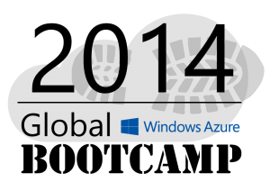
Welcome to the
Perth

Slide 3
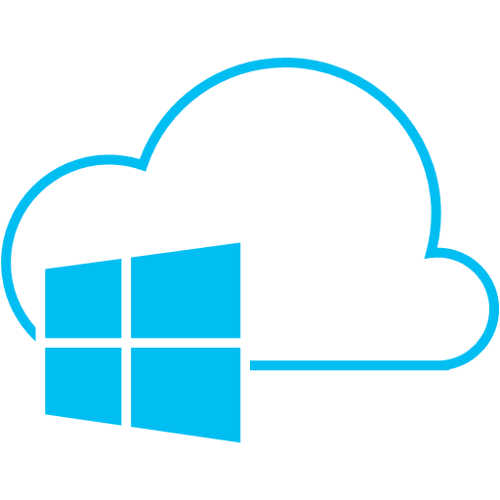









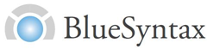





The Sponsors: These guys are doing it globally
A BIG THANK YOU

Slide 4
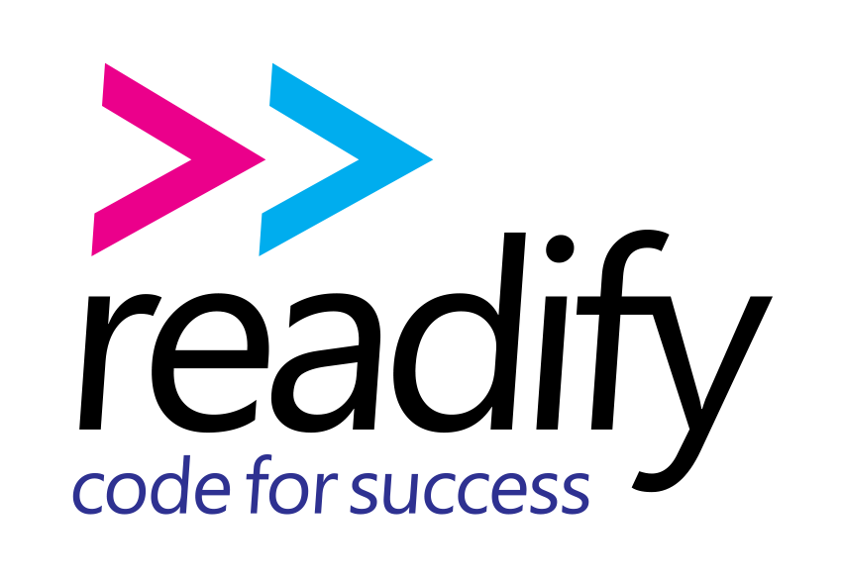


The Sponsors: These guys are doing it locally
Perth MS Cloud UG
A BIG THANK YOU

Slide 5
Windows Azure Overview
Rob Moore
Lead Consultant, Readify
rob.moore@readify.net
@robdmoore
Matt Davies
Senior Developer, Readify
matt.davies@readify.net
@mdaviesnet

Slide 6



Cloud Computing
IaaS
PaaS
SaaS
Infrastructure-as-a-Service
Platform-as-a-Service
Software-as-a-Service
host
build
consume
Notes:
IaaS – a set of infrastructure level capabilities such as an operating system, network connectivity, etc. that are delivered as pay for use services and can be used to host applications.
PaaS – higher level sets of functionality that are delivered as consumable services for developers who are building applications. PaaS is about abstracting developers from the underlying infrastructure to enable applications to quickly be composed.
SaaS – applications that are delivered using a service delivery model where organizations can simply consume and use the application. Typically an organization would pay for the use of the application or the application could be monetized through ad revenue.

Slide 7


Windows Azure Scenarios
Ideal for Applications Needing:
Scalability
Availability
Fault Tolerance
Common Application Uses:
Web Sites
Compute Intensive apps
Device Applications
Web APIs
Hybrid-cloud apps

Slide 8
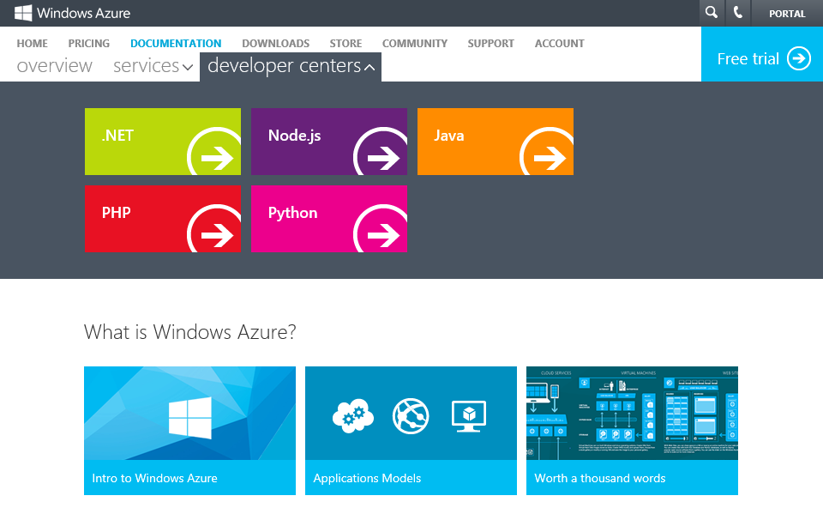
→ http://WindowsAzure.com
Notes:
Tie-in to rename to Microsoft Azure
Speaking Points:
All of these services can also be used from multiple languages
We now have as part of our developer center on WindowsAzure.com support for multiple different languages including .NET, Node, Java, and PHP.
One of the new languages that we’re now enabling is Python with a complete SDK and dev center.
For each of these we provide libraries that you can consume that call into the REST APIs that we expose for the building block services.
You can also call the REST APIs directly

Slide 9
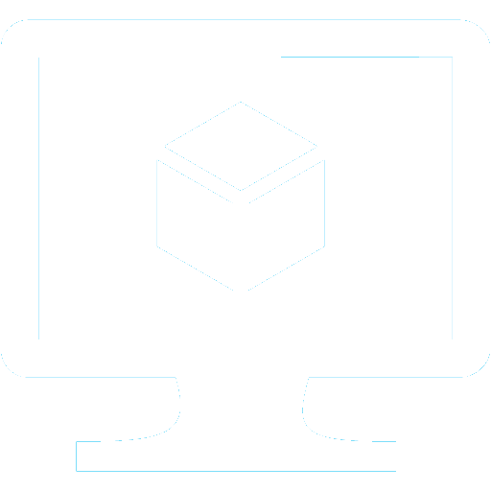














Application building blocks
Virtual Machines
Web Sites
Cloud Services
Mobile
Traffic
Caching
Messaging
Identity
CDN
Media
Networking
Database
BizTalk Svcs
Storage
Big data
Notes:
Speaking Points:
There are numerous terms and definitions floating around in the industry for “the cloud”, “cloud computing”, “cloud services”, etc.
Microsoft thinks of the cloud as simply an approach to computing that enables applications to be delivered at scale for a variety of workloads and client devices.
In addition to the compute services for running your deploying and running your code, Windows Azure also provides a number of application building blocks.
These are managed services that we run that provide a lot of value so you can avoid standing up the infrastructure for common capabilities
You always can stand up VMs and put anything you want in it
But in a lot of cases you will find that we have built in services that we deliver or that are delivered by our partners
What’s cool is that you can use any of these services with a VM, with a Web Site, or with a Cloud Service – so you have flexibility in how you will consume them.

Slide 10

Virtual machines
Windows Server and Linux
Flexible Workload Support
Virtual Private Networking
Notes:
Transition:
For the rest of this talk I’m going to give you a tour of Windows Azure, walk you through many of the features, and ground you in the capabilities it provides
The first set of features I want to walk through is Virtual Machines.
Speaking Points:
If you’re familiar with traditional hosting, this is probably the feature that feels most familiar and consistent with what other hosting providers provide.
The ability to stand up a virtual machine with either Windows or Linux that you can basically remote desktop in or SSH in and run any workload.
These virtual machines enable you to be admin on the box
They are durable, meaning if you reboot the VM, it is still there with all of your changes and data you stored to disk
This means you can run any type of workload
If you want to run SQL you can, if you want to install a no-SQL solution, you can do that to.
If you want to run SharePoint you can do that.
Provides ultimate flexibility to do what you want to do
Also enables you to do what we call virtual private networking
With virtual private networking, you can deploy Virtual Machines in the cloud and group them together so they are part of their own private network
You can also then connect it back to your corporate network (if you have one) and establish a VPN secure tunnel to link your machines running in your own corporate environment up to your virtual machines in the cloud – making them look like they’re all part of one connected network.
So lots of flexibility in the compute side as well as in the networking side.
Portable VHD format, use your own VHDs or move them to your own on-premises
Slide Objectives:
Explain Virtual Machine Portability with the VHD file format
Speaking Points:
There are a few aspects of the Windows Azure Virtual machines feature that are important to understand.
The first, is the support for Virtual Machine Portability
When you create a virtual machine in the cloud, as I just did, you are creating a VHD file
It is encapsulating your OS instance as well as your data
The VHD file format is that it is compatible across Windows Azure, Windows Server, and even Windows client.
VHD is an open specification that we’ve released.

Slide 11

Cloud services
Build infinitely scalable apps and services
Support rich multi-tier architectures
Automated application management
Notes:
Speaking Points:
We’ve talked about Virtual Machines and we’ve talked about Web Sites, now let’s talk about Cloud Services
Cloud Services is another model we support for building applications.
Cloud Services enable a broader set of workloads then Windows Azure Web Sites, while providing more automated management then Windows Azure Virtual Machines.
Enables you to build what we sometimes refer to as infinitely scalable applications. They can support 1 to hundreds or thousands of course
Support not only web based deployments, but also multi-tier architectures where you might have a combination of front ends, middle tiers, as well as virtual machines running as part of your solution.
Supports automated application management, so it is really easy to deploy, scale out, isolate, and recover from any type of hardware failure. As well as support for automated updates.

Slide 12

Web sites
Build with ASP.NET, Node.js or PHP
Deploy in seconds with FTP, Git or TFS
Start for free, scale up as your traffic grows
Notes:
Speaking Points:
Transition
Virtual machines provide a very flexible compute model.
Another compute service available in Windows Azure is called Windows Azure Web Sites.
Definition:
Windows Azure Web Sites there is a managed service that you can use to run web sites and web APIs.
Enable you to quickly stand up web applications and web sites on the internet
Auto-managed environment
Just say that you want a web, here’s the DNS, copy the content, and we do the rest
You don’t have to worry or think about VMs, servers, or infrastructure.
You can simply focus on building and deploying HTTP based applications.
Enables you to build web sites using ASP.NET, Node.js, PHP, and now with an update a few weeks ago – Python
Allows you to use any tool and any operating system to build these sites including Windows, OS X, and Linux.
Enables a very fast deployment model. You can literally deploy in seconds.
You can easily deploy these sites using the tools and infrastructure you know.
We support several flexible deployment options including FTP, GIT, and Team Foundation Services
What is nice about this offering is that not only does it enable to very quickly get going, but it also allows you to start with a free offer in a shared environment.
Pricing starts at free.. Perpetually free and then you can scale up as you need more capability
You can then scale up these sites using reserved instances for higher performance and isolation and scale out these sites as your web site becomes successful and you have increased load.

Slide 13

Mobile Services
Easily build cloud back-ends
Data, identity, push notifications, and scheduled scripts
Windows Store, Windows Phone, iOS, and Android
Notes:
Speaking Points:
Transition:
So we’ve seen three ways to run your code in Windows Azure - Virtual machines, Web Sites, and Cloud Services
Now let’s look at the fourth compute service called Windows Azure Mobile Services.
Definition
Mobile Services is an exciting new service that we introduced about three months ago and we’ve rapidly been updating with new features and services.
I’m sure that many of you today are building device applications that need connectivity to services and data.
Mobile Services are designed specifically to make it really simply for you to build cloud back-ends that power mobile device applications by providing common functionality you need as configurable services.
Features:
Mobile Services provides the ability to easily store and retrieve data, manage users with several different identify providers including Microsoft Account, Twitter, Facebook, and Google accounts, and the ability to send push notifications to devices.
Today Mobile Services has native SDKs for Windows 8 Store applications, Windows Phone apps, and iOS applications.
We’re also adding Android and HTML5 support in the near future.

Slide 14
DB
SQL database
Relational SQL Server Engine in the Cloud
Clustered for high availability
Fully Managed Service
SQL Reporting support
Notes:
Speaking Points:
Let’s walk through some of the building block services that we’re providing and in particular highlight some of the new features of these services.
If you’ve been using Windows Azure you maybe familiar with some of these services. However, there are several new features we’re enabling with all of them.
The first one I’m going to talk about is the SQL Database
SQL Database is a service we’ve had for a while as part of Windows Azure
It provides a relational SQL Server database engine in the cloud
We run the SQL engine for you, we do all of the clustering and availability work for you, so you don’t have to worry about standing up your own clustered environment.
It’s a fully managed service
We also apply security patches and monitor the system

Slide 15

Blob storage
Highly available, scalable and secure file system
Blobs can be exposed publically over http
Continuous geo-replication across datacenters
Notes:
Speaking Points:
We have a great storage system.
We talked about this earlier as part of virtual machines for mounting drives.
You can think of blob storage as a highly available, scalable, and secure file system in the cloud.
You can store any type of data you want in it.
You can optionally expose storage through some HTTP URLs and make it public or you can make it private.
Similar to databases, you can stand up a new storage account in a few minutes.
Continuous geo-replication is enabled by default for storage accounts.
The third aspect of Windows Azure Virtual Machines that is important to understand is ….
Another thing that is nice about the Windows Azure Storage solution is that we have support for Continuous storage geo-replication
What this means is that whenever you save something in the storage system, in the background we can automatically replicate the data to another datacenter
We guarantee that these data centers are several hundred miles (500) apart so that in the case of a natural disaster or a complete data center failure you can be ensured that a copy of your data exists somewhere else.
You don’t have to set anything up to enable it. It’s automatically enabled by default.
You can turn it off if there are policy reasons why you wouldn’t want it enabled.
The end result is that you can deliver more robust solutions with even greater integrity
One of the things that we provide which is a little different with Windows Azure is a really powerful storage architecture
When we booted up our Virtual Machine and you saw all of the disks attached to it, the disks were not actually disks. They were virtual disks on top of our Windows Azure Storage system.
We have redundancy built in for you.
We can also load balance our reads and writes to the drives, so we can provide more predictable performance.
On top of these physical drives that we use for blob storage we also have a set of SSD cache of drives. The benefit is that you are reading and writing through an SSD drive and then back to the physical disk.

Slide 16

Cache
Low latency, in-memory distributed cache
Dynamically grow and shrink cache size
High availability support
Memcached protocol support
Notes:
Speaking Points:
We now have a new distributed cache feature in Windows Azure
It is a low latency, in-memory cache that you can stand up as part of our application
It’s elastic so you can dynamically grow or shrink the cache at will, based on how your application is doing
You don’t have to modify any application code or redeploy your application to increase or decrease the cache size.
Instead just go into the portal say you want more roles and Windows Azure will automatically spin them up
It also has high availability support.
So you can indicate when you cache something that you want to pin the data on at least two cache servers, so if there is a hardware failure you will not loose any data.
The Distributed Cache can be used from any language.
It now supports the Memcach’D protocol, so if you have apps that use Memcached today you can simply point them to the new distributed cache and they will work with no code changes required.
Transition:
Continue last slide
Speaking Points:
Again you can scale up or scale down as needed and we will automatically add and remove the cache for you.
High Availability
If we ever know a machine is going down, for example, you say that you want to remove it from the application then we will actually spend a minute moving all of the data onto other nodes if there’s memory available before we actually take down the machine.
So you don’t actually loose even in a shutdown situation.
Programming Languages
Again you can access this in any language including using the Memcach’d interface

Slide 17
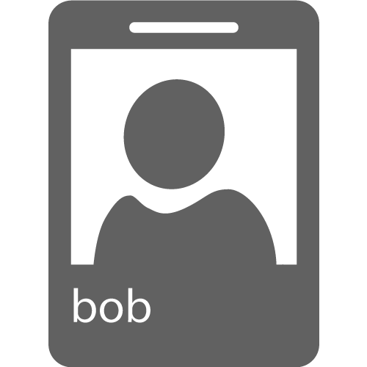
Identity
Integrate with enterprise identity
Enable single sign-on within your apps
Enterprise Graph REST API
93% of Fortune 1000 use Active Directory
Notes:
Speaking Points:
You can integrate with anyone using Active Directory
Once you integrate
You can also take advantage of our new graph API

Slide 18

Service bus
Secure messaging and relay capabilities
Easily build hybrid apps
Enable loosely coupled solutions
Notes:
Speaking Points:
We also have a bunch of new service bus capabilities
The Service Bus is a managed service that provides secure messaging and relay capabilities.
It’s great for integrating cloud based solutions with on-premise environments in a very secure way
and it enables a very loosely coupled architecture
With the new Windows Azure SDK and Tools for Visual Studio, you can now view information about the service bus directly from within Visual Studio.
We are also now introducing cross platform libraries so you can use service bus from any OS whether it’s a VM, web site, or Cloud Service and with any of the languages we support.
Speaking Points:
In addition to queues, the Service Bus also provides a relay capability that can be used to connect through networks and enable hybrid applications.
To see this in action, we’ll take a look at another simple scenario.
In this case we have a SQL database in our on-premises environment (for our demo, my local laptop) and the data is exposed through a simple WCF service
By using the Service Bus relay, we can enable connectivity to our WCF service through Windows Azure
On the front end, we have a mobile web application created with ASP.NET MVC running as a Cloud Service in Windows Azure. This app will connect to the WCF service through the relay and serve up the data to users.

Slide 19

Windows Azure Store
Consume services from ecosystem of partners
Easily try and purchase
Billing integrated within your Azure bill
Notes:
Speaking Points:
In addition to the building block services that we provided from Microsoft, at BUILD we also introduced the Windows Azure Store.
Focused on developer services – both for data, storage options, application monitoring, and more.
Many of these services are recognizable startups such as NewRelic and SendGrid

Slide 20

Global Footprint
Notes:
Speaking Points:
Windows Azure itself is deployed around the world
With Windows Azure, we have a concept of regions, which is where you choose to place your code and run.
In each of the regions, we have a Microsoft datacenter.
These datacenters are massive facilities that host 10s or in some cases hundreds of thousands of servers
We have currently four regions in North America, two regions in Europe, and two in Aisa
As you can see on this slide we also have a number of CDN edge points, which we can use to cache your content and deliver it even faster for customers. %
What you’re going to see in the next couple months and years is that we will rapidly expand our datacenter footprint around the world, so you will have more options for running your applications.
Once you build an application, you can choose where you want to run in the world and you can move your workloads from region to region.
You can also run your application in multiple regions simultaneously and just direct traffic and customers to whichever version of the app is closest to them.
That gives you a global footprint and a chance to reach a bigger customer base or audience in new markets
Notes:
Windows Azure services such as compute and storage are now available in 8 worldwide datacenters with an additional 24 Content Delivery Network endpoints.
You can’t have a real cloud without a data center.
Windows Azure is commercially available in over 89 countries and territories.
Anyone within these countries can sign up for a free trial or a paid subscription to use Windows Azure services
Of course you can build and deliver solutions to any of your customers worldwide.

Slide 21
Getting Started
3 Month Free Trial
MSDN Subscription Benefits
INCLUDES THESE SERVICES:
BENEFITS INCLUDE:
Compute
Storage
Transactions
Bandwidth
Databases
Caching
Access Control
Service Bus
Free Windows Azure access for Professional, Premium, and ultimate subscribers
Designed to accelerate development
Requires credit card at sign-up any overages beyond free allocation
Notes:
Speaking Points:
The final thing I’ll mention about Windows Azure, before we dive into the tour of services is the approach we’re taking with paying for services.
This maybe different for many of you who are familiar with hosting providers and on-premises systems.
With Windows Azure you pay only for what you use.
There are no upfront cost
There is no need to buy any up front server licenses, that’s just included in the price
Likewise if you use a SQL database, through our SQL Database feature in Windows Azure, you don’t have to buy a SQL Server license, that’s also included in the price.
For compute services such as Virtual Machines and Web Sites you only pay by the hour.
This gives you the flexibility to run your applications very cost effectively.
You can scale up and scale down your solutions or even turn them on and off as necessary.
This also opens up a ton of possibilities in terms of the new types of apps you can build

Slide 22
Agenda this morning
http://git.io/gwabperth
Presentation: Web Apps in Azure
Hands-on-lab: Deploy an Azure Web Site
Presentation: Storage / Caching / Databases
Demo: Background Processing
Hands-on-lab: Web Jobs and Azure SQL Database
Presentation: Authentication in Azure
Demo: Monitoring, Diagnostics, High Availability and Scaling
Hands-on-lab: Authentication and Diagnostics
Notes:
Backup: http://bit.ly/gwabperth

Slide 23
The Sponsors: These guys are doing it globally
A BIG THANK YOU

Slide 24
The Sponsors: These guys are doing it locally
A BIG THANK YOU

Slide 25

The Social Fun
Please share our “little” event on the WWW by any means
Use the HASHTAG
#GWAB
extensively

Slide 26
The Social Fun (part deux)
Find all the online locations here
http://bit.ly/gwabflickr
http://bit.ly/gwabTwitter (capital ‘T’)
http://bit.ly/gwabfacebook

